Slide 1
Process and its States

Slide 2
Process
A program in execution is called process. A process is more than the set of instructions, besides it contains memory area, local, global variable, CPU registers, Program Counters.
Process is an active entity that requires a set of resources, including a processors, program counters, registers, registers to perform its functions. Multiple process may associate with one program

Slide 3
Process Concept
Program is passive entity stored on disk (executable file); process is active
  Program becomes process when an executable file is loaded into memory
Execution of program started via GUI mouse clicks, command line entry of its name, etc.
One program can be several processes
  Consider multiple users executing the same program

Slide 4
Process Concept
Multiple parts
  The program code, also called text section
  Current activity including program counter, processor registers
  Stack containing temporary data
    Function parameters, return addresses, local variables
  Data section containing global variables
  Heap containing memory dynamically allocated during run time

Slide 5
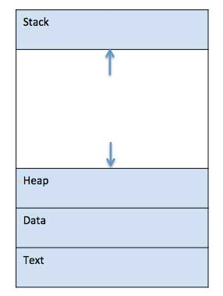
Process in Memory
When a program is loaded into the memory and it becomes a process, it can be divided into four sections ─ stack, heap, text and data.

Slide 6
Types of Processes
CPU Bound Process: If the process is intensive in terms of CPU operations then it is called CPU bound process.
I/O Bound Process: If the process is intensive in terms of I/O operations then it is called IO bound process.

Slide 7
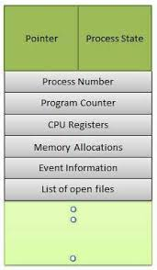
Process Control Block (PCB)
Each process is represented in the OS by a PROCESS CONTROL BLOCK (PCB)- also called Task control Block.

Slide 8
Process Scheduling
Process scheduler selects among available processes for next execution on CPU core
Goal -- Maximize CPU use, quickly switch processes onto CPU core
Maintains scheduling queues of processes
  Ready queue – set of all processes residing in main memory, ready and waiting to execute
  Wait queues – set of processes waiting for an event (i.e., I/O)
  Processes migrate among the various queues

Slide 9
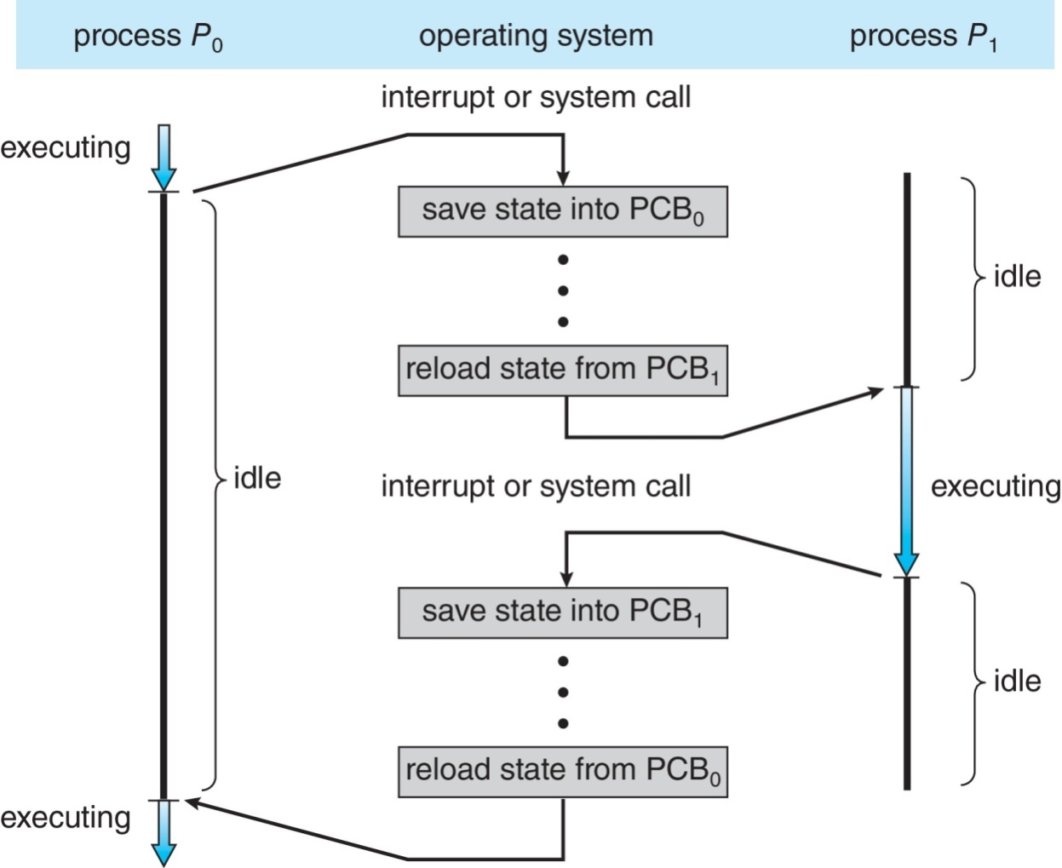
CPU Switch From Process to Process
A context switch occurs when the CPU switches from one process to another.

Slide 10
Context Switch
When CPU switches to another process, the system must save the state of the old process and load the saved state for the new process via a context switch
Context of a process represented in the PCB
Context-switch time is pure overhead; the system does no useful work while switching
  The more complex the OS and the PCB ➔ the longer the context switch
Time dependent on hardware support
  Some hardware provides multiple sets of registers per CPU ➔ multiple contexts loaded at once

Slide 11
Dispatcher
Another component involved in the CPU scheduling function is the Dispatcher.
The dispatcher is the module that gives control of the CPU to the process selected by the short-term scheduler.
This function involves:
  Switching context
  Switching to user mode
  Jumping to the proper location in the user program to restart that program from where it left last time.

Slide 12
Schedulers
Schedulers are special system software which handles process scheduling in various ways. Their main task is to select the jobs to be submitted into the system and to decide which process to run. Schedulers are of three types −
Long-Term Scheduler
Short-Term Scheduler
Medium-Term Scheduler

Slide 13
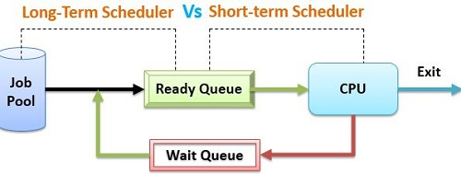
Long-Term Vs Short Term Scheduler

Slide 14
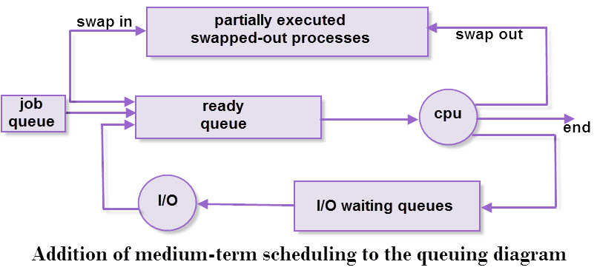
Medium Term Scheduler

Slide 15

Process State Diagram (5-States)
Awake ( Process-name) : New -> Ready
Dispatch ( Process-name): ready -> running
Timerrunout ( Process-name): running -> ready
Block( Process-name): running -> blocked (waiting)
wakeup( Process-name): (waiting) blocked-> ready

Slide 16
Process Scheduling
The process scheduling is the activity of the process manager that handles the removal of the running process from the CPU and the selection of another process on the basis of a particular strategy.
Process scheduling is an essential part of Multiprogramming operating systems.
In a single Processor system, only one process can run at a time; any other must wait until the CPU is free and can be rescheduled.
The Objective of Multiprogramming is to have some process running at all times to maximize the CPU utilization.

Slide 17
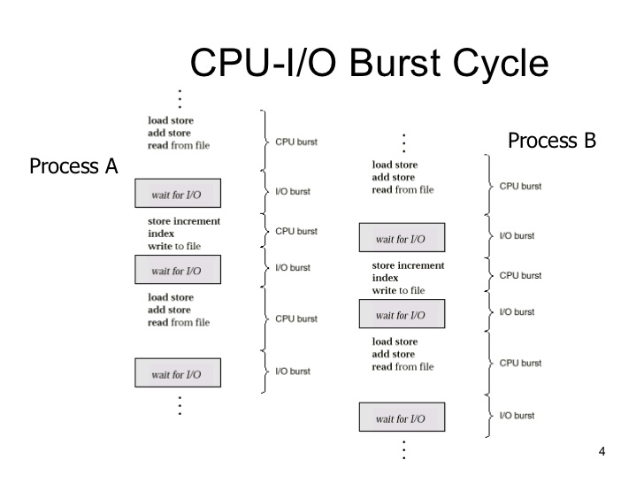
Process Scheduling Conti…..

Slide 18
Type of CPU Scheduling
CPU scheduling decisions may take place under the following four circumstances:
When a process switches from the running state to the waiting state (for I/O request or invocation of wait for the termination of one of the child processes).
When a process switches from the running state to the ready state (for example, when an interrupt occurs).
When a process switches from the waiting state to the ready state (for example, completion of I/O).
When a process terminates.

Slide 19
Type of CPU Scheduling
In circumstances 1 and 4, there is no choice in terms of scheduling. A new process (if one exists in the ready queue) must be selected for execution. There is a choice, however in circumstances 2 and 3.
When Scheduling takes place only under circumstances 1 and 4, we say the scheduling scheme is Non-preemptive; otherwise the scheduling scheme is Preemptive.
Running to Waiting
Running to Ready
Waiting to Ready
Process Terminate

Slide 20
Type of CPU Scheduling
Non-Preemptive Scheduling
Under non-preemptive scheduling, once the CPU has been allocated to a process, the process keeps the CPU until
Process is terminated
Switches to the waiting state.
Preemptive Scheduling
In this type of Scheduling, the process switches the control to another process in following conditions
High Priority Process Arrives
Times Slice Expires
Process completes it I/O Operation
Generate a child process

Slide 21
Concept of Multiprogramming
Pre-emption – Process is forcefully removed from CPU. Pre-emption is also called as time sharing or multitasking.
Non pre-emption – Processes are not removed until they complete the execution.

Slide 22
CPU Scheduling Criteria
Throughput: It is the total number of processes completed per unit time or rather say total amount of work done in a unit of time. This may range from 10/second to 1/hour depending on the specific processes.
Turnaround Time: It is the amount of time taken to execute a particular process, i.e. the interval from time of submission of the process to the time of completion of the process (Wall clock time).
Waiting Time: The sum of the periods spent waiting in the ready queue amount of time a process has been waiting in the ready queue to acquire get control on the CPU.

Slide 23
CPU Scheduling Criteria cont…
Load Average: It is the average number of processes residing in the ready queue waiting for their turn to get into the CPU.
Response Time: Amount of time it takes from when a request was submitted until the first response is produced. Remember, it is the time till the first response and not the completion of process execution (final response).
In general CPU utilization and Throughput are maximized and other
factors are reduced for proper optimization.
CPU Utilization: To make out the best use of CPU and not to waste any CPU cycle, CPU would be working most of the time (Ideally 100% of the time).
Considering a real system, CPU usage should range from 40% (lightly loaded) to 90% (heavily loaded).

Slide 24

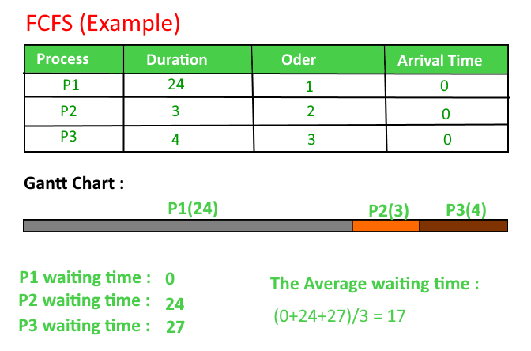
FCFS Example-Q1
Average WT=17

Slide 25
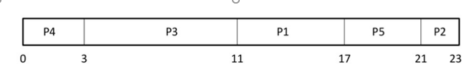
Q2
Process Burst time Arrival time
P1 6 2
P2 3 5
P3 8 1
P4 3 0
P5 4 4
Average WT=8

Slide 26
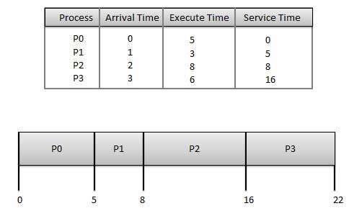
Q3
Average WT=5.75

Slide 27
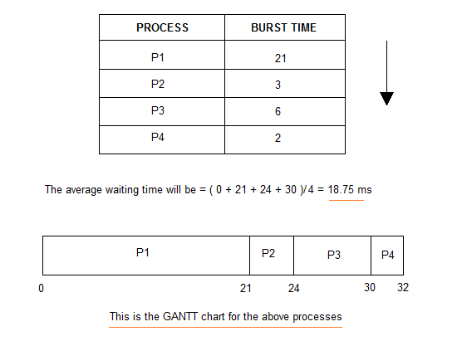
Q4.

Slide 28
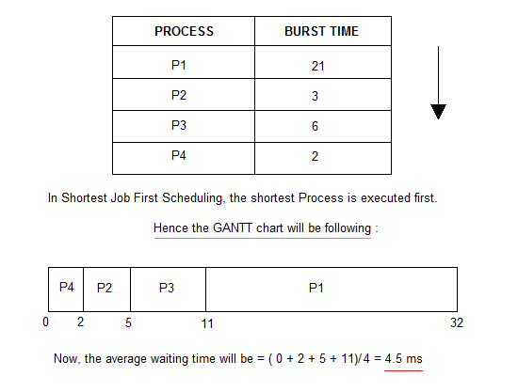
SJF

Slide 29
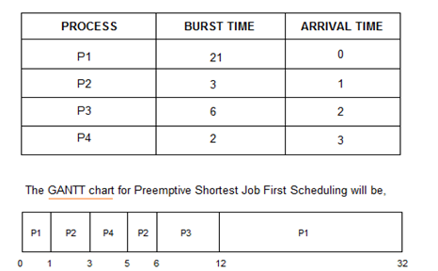
SJF with non-preemptive

Slide 30
Example 2(Non-preemptive)
Process Queue Burst time Arrival time
P1 6 2
P2 2 5
P3 8 1
P4 3 0
P5 4 4

Slide 31
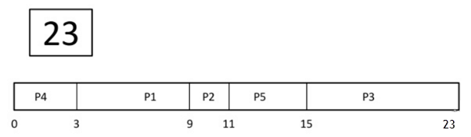
Wait time
  P4= 0-0=0
  P1= 3-2=1
  P2= 9-5=4
  P5= 11-4=7
  P3= 15-1=14
Average Waiting Time= (0+1+4+7+14)/5 = 26/5 = 5.2

Slide 32
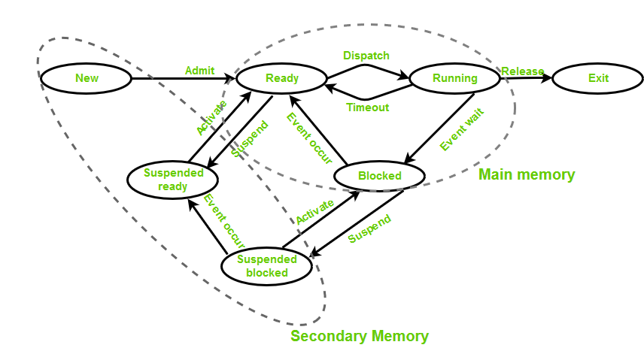
Process State Diagram ( 7 States)

Slide 33
